Slide 1
Lead the creation and promotion of a strong reading culture across your school.
Tracey Ferguson
November 2022

Slide 2
Starter...
What are the features of a strong reading culture in a school?
Notes:
Which of these does you school currently demonstrate?
What could you add?

Slide 3
How to lead and promote a strong reading culture
Is there a strong reading culture in the school?
What/Who are the blockers?
What/Who are the enablers?

Slide 4
Leadership
Creates a vision and builds the capacity of their team to achieve that vision.
A good leader usually brings
about change for the better.
A good leader brings everyone on the journey.

Slide 5
Creates a vision – builds capacity
A vision statement will keep everyone on track
Outline of key goals, values, objectives.
Building capacity – what skills are required?
Notes:
Why is the learning relevant to students?
How can we draw connections to students real-world experiences

Slide 6
Bring everyone on the journey
Know your audience
Checking data – moving forward
Upskilling for all

Slide 7
Creates change for the better
Identify
Identify a 'problem of practice'
Use
Use of data – What data sets?
Create
Create an action plan

Slide 8
A strong reading culture
Students are engaged in their reading – routines are in place – expectations are clear.
Data shows that students regularly and consistently make growth
Evidence of reading is visible across the school

Slide 9
Kids are engaged in reading!
Evident in observations
The Library is a vibrant hub of the school
Reading practices are supported by staff across the school

Slide 10
Use of data as evidence
Know what data to access – borrowing stats, reading classes
Measure and evaluate
Use for goal setting and celebration when goals are achieved

Slide 11
Evidence of reading across the school.
Staff are upskilled in reading strategies
All faculties have reading strategies embedded in their curriculum as a key skill
Students accept that reading is a whole school activity – not just in English
Notes:
Create time for PD for all staff.

Slide 12
Identifying a problem of practice
Audit current practices – what is working?
Build and extend on that.
What is not working?
What needs to change?
https://padlet.com/tf020760901/slav
Notes:
Audit current practices – what is working?
Build and extend on that.
Eg classes are coming into library, but teacher is disengaged – marking, on computer.
What is not working?
What needs to change?
Implement a lesson plan with inbuilt levels of accountability.
Use of data to create a sense of urgency – borrowing stats, reading conference notes.

Slide 13
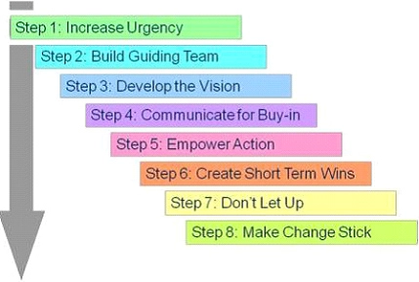
Leading change
Kotter's 8 step Model of Change

Slide 14
Kotter's 8 step Model of Change
1. Creating an Urgency:
Inspire people to act:
Present data – borrowing statistics, class attendance in the library, teacher impact, literacy data
Use of a Padlet/Menti to identify problems of practice – pose a thoughtful question
2. Forming Powerful Guiding Coalitions
Identifying the effective change leaders in your organizations and key stakeholders – who would be positive members of your team?
3. Developing a Vision and a Strategy
Determine goals, values and objectives. What is the reason for change?
Describe the vision effectively and in a manner that people can easily understand and follow.
Notes:
Sources:
https://www.kotterinc.com/methodology/8-steps/
https://www.managementstudyguide.com/kotters-8-step-model-of-change.htm
Use of a Padlet to identify problems of practice – pose a thoughtful question
Thinking about a reading task that you ask students to complete – what gets in the way?

Slide 15
Kotter's 8 step Model of Change
4. Communicating the Vision – forming a coalition
Communicate the change in the vision very often powerfully and convincingly.
Staff meetings, KLD meetings, briefings, newsletter/FB. Enlist a volunteer army.
5. Removing Obstacles
Continuously check for barriers or people who are resisting change.
Implement proactive actions to remove the obstacles involved in the process of change.
Reward people for endorsing change and supporting in the process – staff recognition
6. Creating Short-Term Wins
Create short term targets to ensure 'quick results – quick wins'.
Reward the contributions of people who are involved in meeting the targets.

Slide 16
Kotter's 8 step Model of Change
7. Consolidating Gains
What worked? Build on those successes!
8. Institute change
Share and promote success stories – with broader school community – FB, newsletters
Ensure that the change becomes an integral part in your organizational culture and is visible in every organizational aspect.
Ensure that the support of the existing leaders as well as the new leaders continue to extend their support towards the change.

Slide 17
Recognise staff contribution
The spinning wheel of names and a Google form for nominations at staff meeting/briefing

Slide 18
Reading promotion
A journal...

Slide 19
Reading promotion
Reading café with loyalty card – silent reading session at lunchtime with a cup of Milo
Teachers also welcome

Slide 20
Dress up!
Halloween and Book Week

Slide 21
Reading promotion
The Great book Swap

Slide 22
Reading promotion
Student recommendations...

Slide 23
Reading promotion
Reading competitions

Slide 24
Guskey model of professional learning
Teachers need to see positive change in student attitude and behaviour to adopt new teaching practices = change
Staff development and the process of teacher change. Educational Researcher, 15(5), 5-12. Hargreaves, A. (1994).

Slide 25
Guskey model of teacher change
Notes:
Source: Bastow Leading Literacy course

Slide 26
Guskey model of teacher change
Librarians lead this change in teacher’s practice
Modelling best practice in library sessions:
Student engagement – library events
Student choice – books on display
Teaching reading comprehension strategies
Resourcing the curriculum – Information literacy

Slide 27
Talking data... As an Instructional Leader, I am familiar with data sets that I can access to support my practice
Whole school data - Naplan, VCE
Cohort data – In-school literacy testing
Individual data – Students requiring intervention
Notes:
Whole school data - Naplan, VCE – are students reading the class texts?
Cohort data – In-school literacy testing, borrowing stats of students in reading programs, teacher impact (PAT data across year 7 reading)
Individual data – Students requiring intervention - The library is a resource for students with additional needs – can you access speech to text, audio books, books for dyslexic student, 'high interest, low level books.

Slide 28
Bringing it all together

Slide 29
Creating a whole school reading model
Emerald Secondary College reading model
This Photo by Unknown author is licensed under CC BY-SA.

Slide 30
Objectives
To create a consistent approach to reading strategies across the College
To improve the level of ‘low’ growth from students 7-9

Slide 31
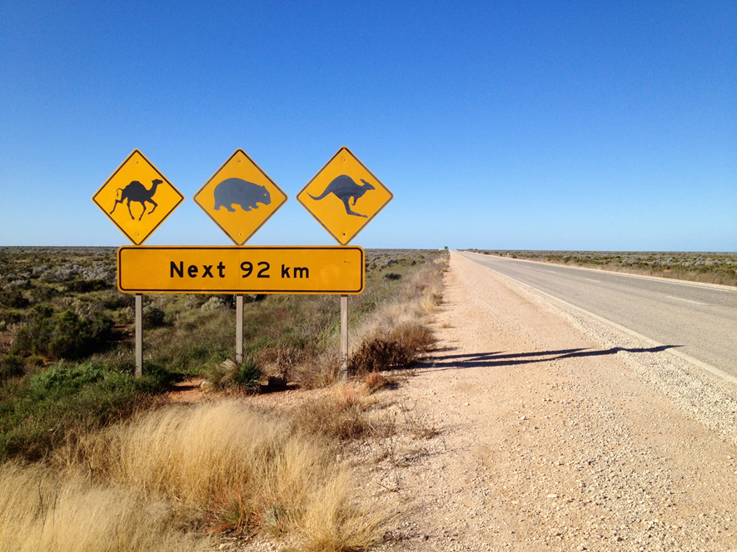
Notes:
Liken the Literacy journey to a Road trip
a long way to go
there will be some hazards along the way
when with a group - some will become lost, need to guide them back on the track
The question that everyone asks: Are we there yet?

Slide 33
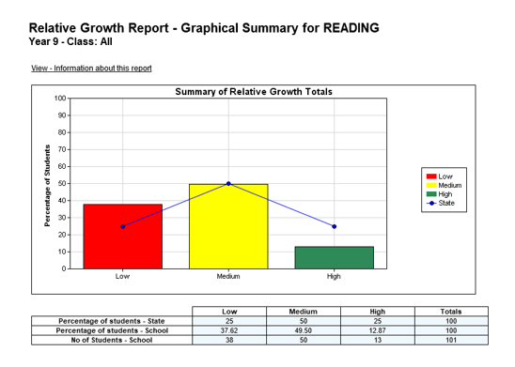

Slide 34
We can change our results...
By getting new students
Changing what we do

Slide 35
Building a reading culture
When you ask students to ‘read’ a text – what happens?
Add your thoughts to the padlet…
Notes:
Read the short story of "Looking for William" - Christine Harris
Demonstration to staff that 'good readers' already have strategies.
These need to be explicitly taught to our less able readers.

Slide 36
Teachers as readers – skills readers use
Longing for William - (in Buried Secrets by Christin Harris)
Who is the narrator?
What skills did you use to work that out?
Add your thoughts to the menti…
Notes:
Read the short story of "Looking for William" - Christine Harris
Demonstration to staff that 'good readers' already have strategies.
These need to be explicitly taught to our less able readers.

Slide 37
What good readers do...
Demonstration of Reading Comprehension strategies – Bookmarks
1: Monitoring comprehension – The inner conversation
2: Activating and connecting to prior knowledge
3: Questioning: The strategy that propels readers forward
4: Visualizing and inferring
5: Determining importance in text
6: Summarizing and synthesizing information
7: Content Literacy – reading across the curriculum
8: Topic studies: A framework for research and exploration
9: Reading to understand textbooks
10: The genre of text reading
Notes:
Source: Stephanie Harvey – Strategies that work

Slide 38
Whole school reading strategies...
Select a reading strategy that resonates with you…
Suits your subject area
Suits the reading material
You feel comfortable with
Create an activity for reading in your next class.

Slide 39
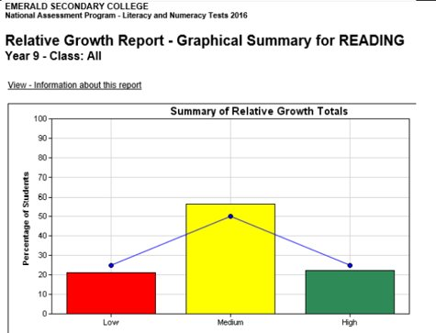

Slide 40
In closing...
What is a new learning for you?
What difference will this make to your work?
How can you make the most of this learning?
Feel free to contact me:
Tracey Ferguson: tracey.ferguson@education.vic.gov.au
Observations are welcome @ Officer Secondary College

